Slide 1


Slide 2
Selection Decision Table

Slide 3
Decision-making is a process in which a final outcome is derived by evaluating and analyzing the given data.
The objective of decision-making is to reach a certain conclusion from the given information or a given set of conditions

Slide 4
Selection Decision Table
Read the problem carefully and make sure you understand the requirements. Identify the inputs, conditions, and outputs.
Use the conditions and rules to determine the correct output for each combination of inputs.

Slide 5
Selection Decision Tables Tips, Tricks and Shortcuts
A selection decision table is a method of making decisions based on the information provided. It is a concise visual representation for specifying which actions to perform depending on given conditions.
Before creating a decision table, it’s important to understand the problem you’re trying to solve and the business rules involved
Identify the conditions that affect the outcome of the decision and the actions that need to be taken based on those conditions
Create a table with the conditions listed in the leftmost column and the actions listed in the top row
Fill in the table with the appropriate values for each combination of conditions and actions
Check that all possible combinations of conditions have been considered and that there are no gaps or overlaps in the table
Look for ways to simplify the table by combining similar conditions or actions

Slide 6
To solve decision making questions in a fast and understandable way we have divided these into the 2 parts:-
Type 1: Judgement & Decision Based On Qualification Or Skills
Type 2: Judgement & Decision Based On Combinations or Traits or Behaviour.

Slide 7
Important Properties:
A selection decision table is typically represented in a tabular format, with rows and columns.
The conditions or inputs are the factors that influence the decision-making process.
The actions or decisions are the possible outcomes or choices that can be made based on the conditions.
Decision tables allow for easy comparison of different conditions and actions.
Decision tables follow a logical structure, where the conditions and actions are organized in a systematic manner.

Slide 8
Type 1 : Judgement & Decision Based On Qualification Or Skills

Slide 9
In each of the given below. You have to study the information provided with reference to the condition given and decide whether the candidate is to be called for an interview or some other course of action is to be taken.
You are not required to assume anything other than the information provided to you in each question. All these cases are given to you as of 1st Nov,2017.
Now, read the information provided in each question and decide the courses of action with regards to each candidate.

Slide 10
Give answer
If the candidate is to be called for an interview.
If the case is to be referred to the general manager.
If the candidate will not be called for an interview.
If the data provided are not sufficient to take a decision.
If the case is to be referred to the deputy general manager.
Notes:
Ans: d

Slide 11
Read the following information carefully and answer the question
A company has following Gratuity (G) and provident Fund (PF) rules:
An employee must have completed one year's service to be eligible for either G or PF.
An employee resigning, retiring, or retrenched after ten years of service gets both G and PF.
An employee who retrenched or retired after five years but before 10 years of service gets both G and PF, but who resigns during this period gets either G or PF.
An employee retrenched or retiring before 5 years' service gets PF but not G, but resigning during this period gets neither G nor PF
However, in case an employee dies after 2 years of service, his family gets both G and PF
in case an employee was on leave without pay, such period is deducted from his total years of service and then the above rules are applied.
in the case of a lady employee, if she has completed 2 years of service, two years are added to her actual service before applying
the above rules, as a special consideration
Notes:
Retrenched - the removal of employees, typically due to economic reasons like company restructuring, mergers, or cost-cutting measures. It isn't usually a reflection of the individual employee's performance but rather broader organizational challenges.

Slide 12
min 1 yr
>10 G+PF
5-10 retrench/retire G+PF
resign G or PF
<5 retrench/retire PF G (X)
resign (X)
2 yr Die G+PF
leave (X)
lady (>2 yrs) 2 yrs added

Slide 13
Que: Tony Kakkar serving in a Music company for five years out of one year he was on leave without pay, was retrenched from the service.
If only G can be given
If only PF can be given
If either G or PF can be given
if both G and PF can be given
If neither G nor PF can be given
Notes:
Ans: b
< 5 yes retrench - PF & not G

Slide 14
Que: Miss Monika served for 3/2 years and was retrenched.
a) If only G can be given
b) If only PF can be given
C) If either G or PF can be given.
D) If both G and PF can be given
E) If neither G nor PF can be given
Notes:
Ans: b
<5 retrenched only PF

Slide 15
Que: Mr. Aatmaram Tukaram Bhide was retrenched from service as a Gokuldam Society Secretary after seven years.
If only G can be given
If only PF can be given
If either G or PF can be given
If both G and PF can be given
If neither G nor PF can be given
Notes:
Ans: d
7yrs retrenched
> 5 but < 10 retrenched

Slide 16
Que: Mrs. Sharma served the company for four years and resigned.
If only G can be given
If only PF can be given
If either G or PF can be given
If both G and PF can be given
If neither G nor PF can be given
Notes:
Ans: c
4 +2 = 6 yrs
>5 but < 10 resign – G or PF

Slide 17
Que: Mr. Smith served in Ship Making Company for seven year and resigned after a prolonged illness of three years for which he was on leave without pay.
If only G can be given
If only PF can be given
If either G or PF can be given
If both G and PF can be given
If neither G nor PF can be given
Notes:
Ans: e
< 5 yrs resign – not G or P

Slide 18
Question :
The requirements for enrolling a student in Medical Colleges are as follows.
possess a 12th-grade in science with a minimum % average of 75.
as on June 30, 2022, be at least 20 years old.
have obtained a 70% on the entrance exam.
possess the financial means to pay the 25,000 rupee entry fee.
If a person meets all of the requirements listed above with the exception of (3) and has passed the scientific tests for the 12th grade with an 85 percent grade, they should be reported to the appropriate authorities.
If the applicant meets all of the requirements above, with the exception of (4), and is able to pay half the fee at the time of admission, they may be provisionally accepted.

Slide 19
1. Siddharth Malhotra turned 19 on January 15th, 2021. He had a 78% success rate on his math and science examinations for the 12th grade. His entrance exam score was 76 percent, making him eligible to pay the Rs 25,000 admission fee. Should he be admitted to Medical College.
Admitted
Not Admitted
Admitted Tentatively
None of the above
Notes:
Answer: A
Explanation:
Sidharth Malhotra satisfies the second criteria because, as stated in the rules, He was 19 years old on january 15th, 2021. Additionally, he satisfies the first, third, and fourth standards by earning 78 percent on the 12th grade exam, 76 percent on the entrance exam, and the ability to spend 25,000 for admission. he would therefore be accepted into the Medical College.j

Slide 20
2. Rishabh Pant turned 18 on 21st May, 2018. In the science and math parts of his 12th-grade tests, he received an 80 percent. he passed his entrance exam with a score of 69 percent and is eligible to pay an admission fee of Rs 25,000. Will he be allowed to register in the Medical college?
Admitted
Not Admitted
Admitted tentatively
Raised to authority
Notes:
Answer: Not Admitted
Explanation:
As mentioned in the standards, Rishabh Pant was 18 years old on 21st May 2018, he does not fulfill the second standard. he fulfills the first and fourth standard as he scored 80% in his 12th standard science exams with Math and can also pay 25,000 for his admission fee. But he fails to fulfill the third standard of scoring 70% marks in entrance examination. As he fails to fulfill the second and third standards he cannot be admitted to the Medical College.

Slide 21
3. In her science exam for the 12th grade, Ayushi received a score of 72%. On June 30, 2010, She turned 20. She received 92 percent on the entrance exam, which was the highest score. Should the Medical College accept her?
Admitted
Not Admitted
Admitted Tentatively
Data Insufficient
Notes:
Answer: D
Explanation: The data is insufficient to answer the issue based on the information provided in the question and the standards specified above. Ayushi met the first and third requirements by successfully earning excellent scores in both the entrance exam and higher secondary exam. She also satisfies the second requirement because she was 20 years old on June 30, 2010. However, no information is provided on the entrance cost. The information provided in the data is therefore insufficient.

Slide 22
Type 2: Judgement & Decision Based On Combinations Or Traits Or Behaviour

Slide 23
Question :
The management of KV International School has received written complaints from parents of female child. They mentioned about bad behavior of boys with girls during dance & sports sessions. The management gave the responsibility of this overall task to the extra curriculum officer of the school. The officer wants to examine and finish this problem as quickly as possible and started sitting in all the dance and sports classes regularly. Now which state of affairs should the extra curriculum officer report to the management?
A. A small girl is standing alone during sports session and not doing anything except reading a novel.
B. One boy and one girl are making their own pair and trying to learn salsa.
C. Four boys are close to one girl and look like they want something from her bag.
D. Two girls are watching movie in the amphitheater which they are not supposed to do except special sessions.
Notes:
Answer: C
Explanation:
The incident C is the most serious one. If the four boys in a group will ask forcefully something to a girl then there are chances of feeling insecure or uncomfortable by any one.

Slide 24
Read the following information carefully to answer these questions.
Amit shah, director of Apollo fortis, specified some conditions for selecting candidates for interview for recruitment of Medical Representative for a company:
The candidate must :
A. Be a graduate in science with Chemistry and Botany and/or Zoology. B. Have 60% and above at SSC and 50% and above at graduation C. Not be more than 25 years of age as on 1st Jan, 1997 D. Have at least represented school/college in any inter-school/college competitions E. Have passed the selection test with 55% and above marks F. Enclose recommendation of two persons who are not his/her relatives.

Slide 25
However, in the case of a candidate who fulfills all other criteria except:
A above, but has passed MSc in Chemistry with 60% or above marks, should be considered for waiting list for interview.
II. B above, should be referred to Manager of Administration.
III. F above, should be called to meet Manager HRD.
Based on these criteria and information provided below, decide the course of action in each case. You are not to assume anything. If the data provided is not adequate to decide the course of action, your answer will be data inadequate. These cases are given to you as on 1st Dec, 1996.

Slide 26
Question :
Sachin Tendulkar has represented his school and college in Cricket and Chess. He has passed his BSc in Chemistry, Physics and Mathematics at the age of 20 years in 1994. He came 2nd in the merit list in the selection test with 78% marks and has enclosed two recommendations. He has scored 62% and 65% in SSC and BSc, respectively.
Not to be called the interview
Data inadequate
To be called for interview
Refer to Manager – Administration
To be waitlisted
Notes:
Answer : Not to be called the interview
Explanation : Sachin Tendulkar does not qualify for interview as he did not pass B.Sc with Chemistry, Botany or Zoology.

Slide 27
Question :
Ms. Kareena kapoor, a Kathak dancer, who has won inter-University prizes, is a brilliant student holding 1st rank in MSc (Chemistry) in 1996 as well as selection test. She has had more than 75% marks in the examination right from SSC to BSc (Chemistry-Botany). All her teachers speak hightly about her.
Not to be called for interview
Data inadequate
Refer to Manager – HRD
To be waitlisted
To be called for interview
Notes:
Answer: Data inadequate
Explanation : Age of the candidate is not given.

Slide 28
Question :
Rashmi desai, who has been recommended by two actresses working in TV serials, is 23 years with Master’s degree in Chemistry. She has won prizes in acting in inter-university drama competitions. She has obtained more than 70% marks in SSC, BSc (Chemistry, Botany) and the selection test.
To be waitlisted
Not to be called for interview
Refer to Manager – Administration
Refer to Manager – HRD
To be called for interview
Notes:
Answer: To be called for interview
Explanation : The candidate, fulfils all the conditions as laid down in the question, and hence should be called for interview.

Slide 29
Question :
Kiara Advani born on 19th Nov, 1974 is a post graduate in Chemistry. At graduation she had Chemistry, Zoology and Botany. She had represented her school and college in sports and drama. Her father is a successful doctor. She has passed the selection test with 62% marks and has enclosed recommendation of President and Vice-President of the Chemist’s Association.
To be called for interview
Data inadequate
Not to be called for interview
To be waitlisted
Meet Manager – HRD
Notes:
Answer: Data inadequate
Explanation : Data is inadequate, as qualification with regard to Condition B, percentages at SSC and graduation level are not given.

Slide 30
Question :
Rahul dravid won inter-college tournament for table-tennis in 1995 while doing his final year of BSc with Chemistry and Zoology. He has passed with more than 60% marks in all the examination right from SSC to selection test held by the company. He has enclosed two good references, one from college principal and another from an industrialist. His father works in a bank.
Data inadequate
To be called for interview
Not to be called for interview
Refer to Manager – HRD
To be waitlisted
Notes:
Answer : Data inadequate
Explanation : Data is inadequate, as Condition C is not given.

Slide 31
Question 2:
Six friends Ramesh, Dinesh, Lokesh, Nilesh, Shailesh and Hitesh work in different companies namely, P, Q, R, S, T and U and each one wears company sponsored ties of different color i.e. blue, green, pink, yellow, purple, red. 1.The one wearing blue tie works in company S and the one wearing green tie works in company P. 2.Hitesh does not work in company R or T. 3.Ramesh wears pink tie and works in company Q. 4.Nilesh does not work in company T and purple color tie is not sponsored by company R. 5.Company T does not sponsor purple or yellow colored tie and Lokesh works in company P
2.1. Which company sponsers red tie?
Notes:
Ans : Red Tie - Company T

Slide 32
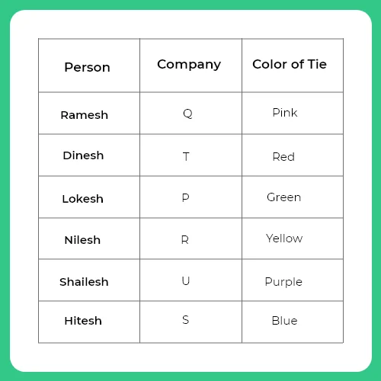

Slide 33
2.2
Which company does Nilesh work?
Notes:
Ans : Nilesh - Company R

Slide 34
2.3
Which color tie does Shailesh wear?
Notes:
Ans : Shailesh - Purple

Slide 35
2.4
Which company sponsors yellow color tie?
Notes:
Ans: yellow - R

Slide 36
Question 3:
Read the information and answer the questions that follow: P, Q, R, S, T, V and W are travelling in three different vehicles. There are atleast two passengers in each vehicle –I, II AND III and one of them is a lady. There are two engineers, two doctors and three teachers among them. R is a lady doctor and she does not travel with the pair of sisters P and V. Q a male engineer travels only with W, a teacher in vehicle I. S is a male doctor. Two persons belonging to same person profession do not travel in the same vehicle. P is not an engineer and travels in vehicle II. 3.1. What is P’s profession?
Notes:
Ans : P - Teacher

Slide 37
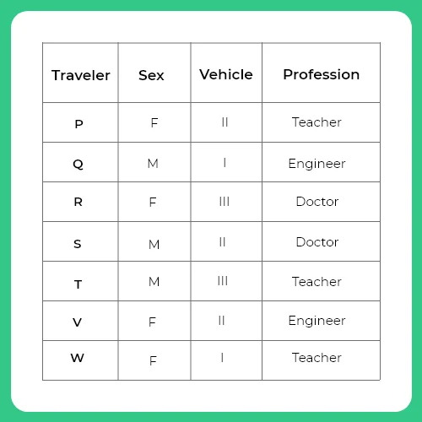

Slide 38
3.2
Which vehicle does R travel?
Notes:
Ans : R - III

Slide 39
3.3
Which of the following pair is correct travelling in vehicle II?
Notes:
Ans : PSV

Slide 40
Question 4:
You are a General Manager-Human Resources in the Education Department of, where you are dealing with the appointment of ‘Project Managers’ based on preliminary scrutiny and face to face interview. 10 candidates have been shortlisted for one single post. You have to make your recommendation on the basis of candidate’s educational qualification and previous work experience. You have to suggest 3 best candidates in order of preference. A senior IAS officer in the education department, who is known to you, asks you to suggest the first 3 best candidates. How will you decide?

Slide 41
A. Bring the matter to the CEO of your company and will ask him what to do?
B. There is one candidate who is known to you. His father daily calls you by offering the amount of Rs.15 lakh for the selection of his son. You will simply put his name on top despite knowing that he is not among the best three.
C. Examine the profile of all 10 candidates following with face to face interview round and will take a decision after that.
D. Make sure that the recommended candidate is not selected at all. You should place him in the down.
E. You should first see who are schedule cast candidates in the list and make sure that at least 1 recommendation should be consisting of SC & ST candidates.
Notes:
Answer: C
Explanation:
The best decision out of all will be to examine the profile of all the candidates and to take decision on the basis of merit only. Thus the correct answer is option (C).

Slide 42
Question 1:
Read the information and answer he following questions
P, Q, R, S, T, U, V and W are seven members of a family. Each one of them has a different profession-doctor, teacher, lawyer, engineer, architect, chartered accountant and banker and their incomes are different. There are two married couples in the group. R is the doctor and earns more than the engineer and lawyer. T is married to the chartered accountant and she earns the least. No lady is either lawyer or engineer. Q, the teacher, earns less than P- the banker. W is married to Q and he earns more than S and P. v is not the lawyer. The Chartered accountant earns less than lawyer but more than the banker.

Slide 43
1.1
Who earns the second highest in the family?

Slide 44
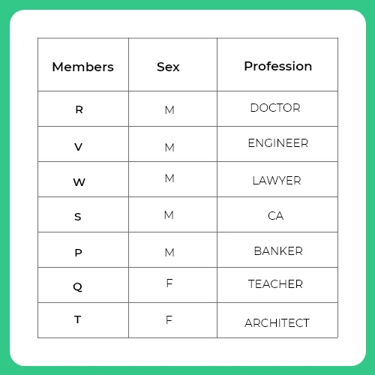
Notes:
Members are arranged in decreasing order of their income from Top to bottom so V earns the second highest in the family

Slide 45
1.2 What is the profession of the highest earning member in the family?
Notes:
Ans : R
Doctor

Slide 46
1.3
What is the profession of T?
Notes:
Ans : Architect

Slide 47
1.4
How many male members are there in the family?
Notes:
ANS : 5

Slide 48
1.5
Who is the engineer in the family?
Notes:
Ans : V

Slide 49
THANK YOU

